Slide 1
Gathering Insights from Movie Reviews with Text Processing and AI
BUAN 6390.001 - Analytics Practicum - F25
Group 6
Priyadarshan Parida
Sunayana Jana
Soniya Rajappan

Slide 2



Problem Statement & Objectives
Problem Statement
Over 80% of viewers check reviews before watching a movie
Streaming platforms depend heavily on user reviews for rankings & recommendations
Movie reviews are unstructured, subjective, and often inconsistent
Need a scalable approach to analyze thousands of reviews efficiently
KNIME for text processing, ML clustering, and GenAI sentiment; delivered insights through Data App
Why It Matters
Helps studios and platforms improve recommendations, marketing, and content decisions
Research Questions
How do ML and GenAI differ in sentiment accuracy and what reviewer clusters and movie patterns emerge?
Compare ML and GenAI sentiment
Measure sentiment-model effectiveness
Segment reviewers by text patterns
Identify distinct taste clusters
Scope & Assumptions
Insights focus on text patterns; no genre data available; sentiment assumed to reflect true opinions
Key Comparison Criteria
Accuracy, Precision, F-score, Recall, Segment distribution and Word-cloud,
Rank movies using sentiment scores
Identify top and bottom 10 movies
Build KNIME Data App
Summarize insights for decisions

Slide 3







Methodology Snapshot
IMDB Data Ingestion
Text Clean-up & Normalization
Traditional ML Sentiment Analysis
GenAI Sentiment & Aspects Analysis
Reviewer Segmentation
KNIME Data App & Insight Summary
Text Processing
Traditional ML
Generative AI
Data App
Stopword Filter, Snowball Stemmer, BoW, TF-IDF
Naïve-Bayes, SVM, Logistic Regression, k-Means
OpenAI Authenticator, LLM Selector, LLM Prompter
Bar charts, Heatmaps, Components
Traditional ML Interpretable and lightweight, easy to audit and scalable models.
Tools Used
GenAI captures latent semantic relationships using LLM-derived contextual embeddings.
Clean and structure raw text for analysis
Sentiment scoring and reviewer segmentation
General and Aspect-based-sentiment-analysis and insights
Deliver insights through dashboard
Purpose
Comparison ensures holistic solution that can be adopted based on purpose and ROI.

Slide 4
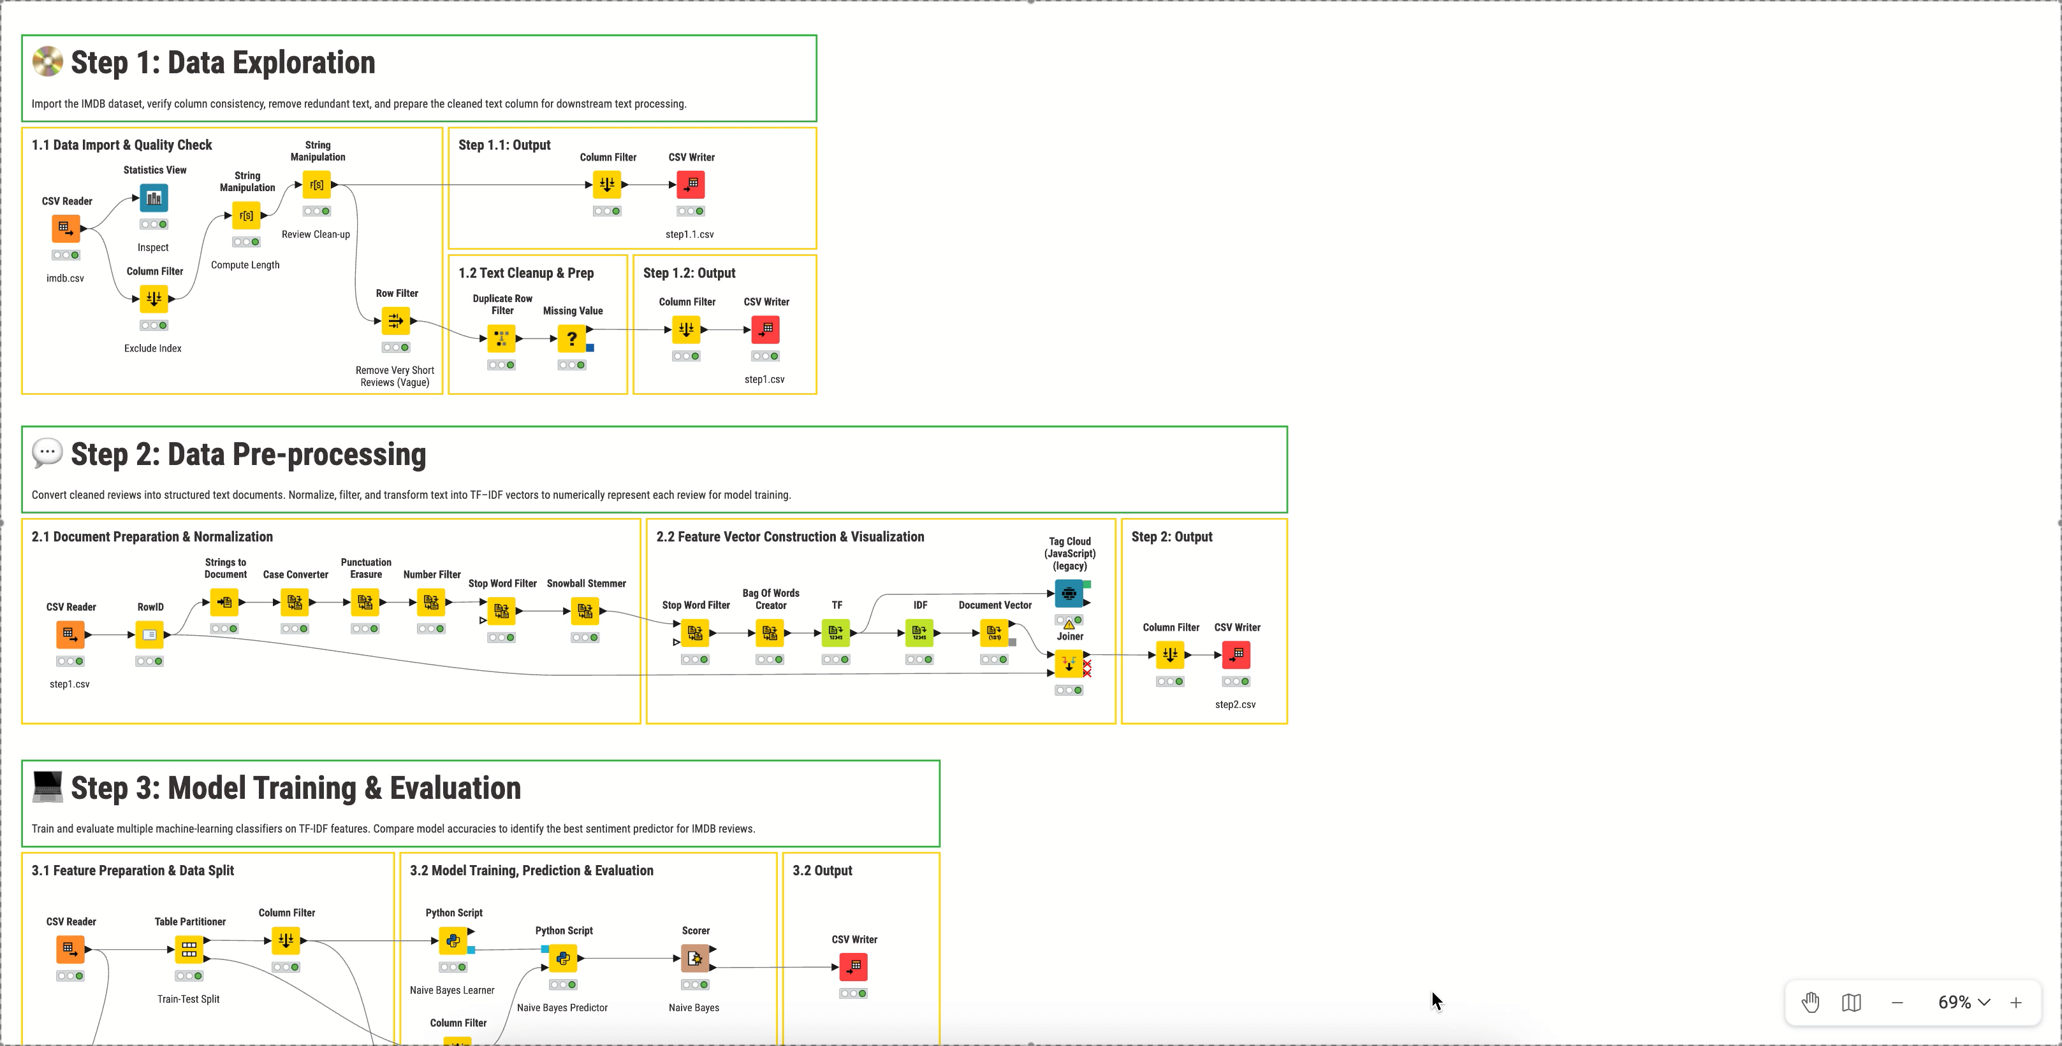
KNIME Workflow

Slide 5
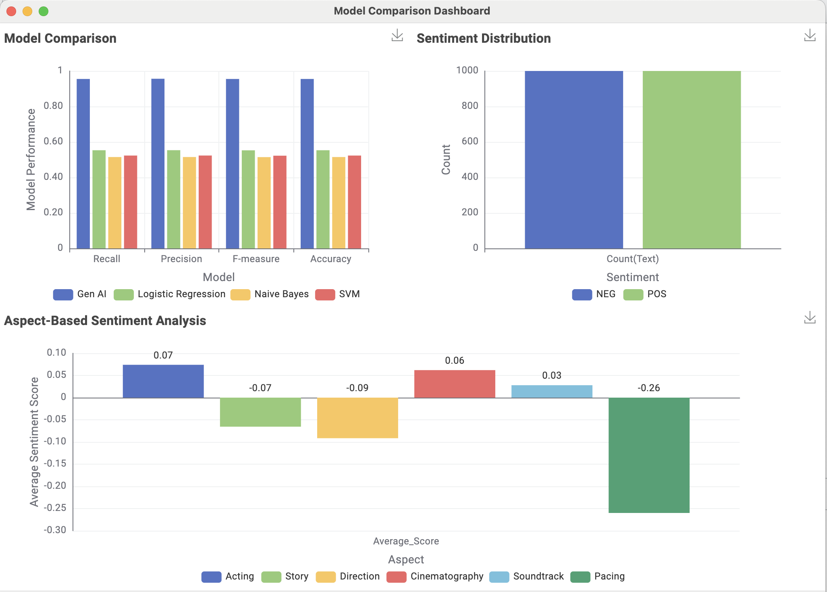
Traditional ML vs Generative AI – Model Comparison
Key Insights
GenAI achieved 90%+ accuracy, outperforming all ML models
(48–53%)
Traditional ML had limited capability with interpreting deeper semantics
GenAI captured thematic nuance and inferred sentiment effectively
Balanced dataset rules out any performance gaps due to class imbalance
Aspect analysis: Acting & Cinematography positive, Pacing strongly negative
ML offers a simple, fast baseline; GenAI for depth and accuracy

Slide 6
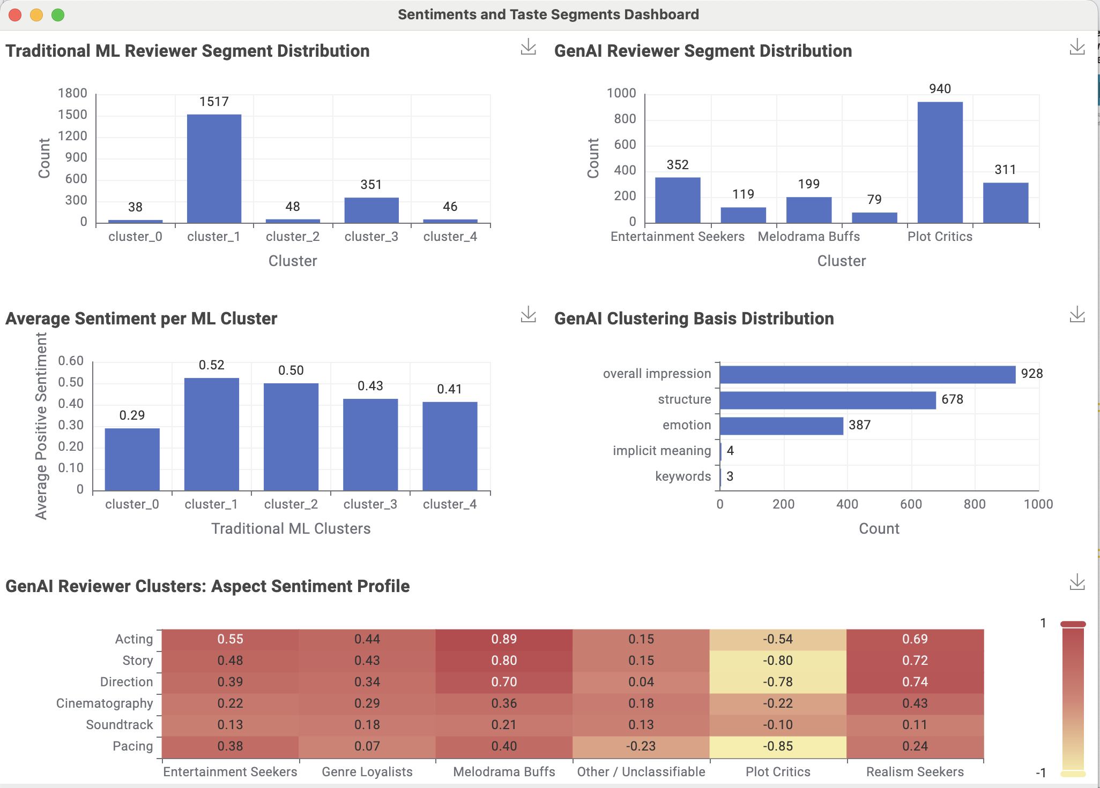
Sentiments and Taste Segments
Key Insights
Traditional ML based clustering missed most of the semantic context leading to misclassification
GenAI produces clearer, interpretable reviewer personas - Entertainment Seekers, Melodrama Buffs, etc.
GenAI based clustering was backed by meaningful clustering basis
Sentiment varies strongly across ML clusters (0.29–0.52 spread)
Aspect profiles reveal what each segment values. Melodrama Buffs love Acting; Plot Critics dislike Pacing
Plot Critics consistently score lowest across aspects

Slide 7
Sentiments and Taste Segments
Key Insights
Traditional ML based clustering missed most of the semantic context leading to misclassification
GenAI produces clearer, interpretable reviewer personas - Entertainment Seekers, Melodrama Buffs, etc.
GenAI based clustering was backed by meaningful clustering basis
Sentiment varies strongly across ML clusters (0.29–0.52 spread)
Aspect profiles reveal what each segment values. Melodrama Buffs love Acting; Plot Critics dislike Pacing
Plot Critics consistently score lowest across aspects

Slide 8
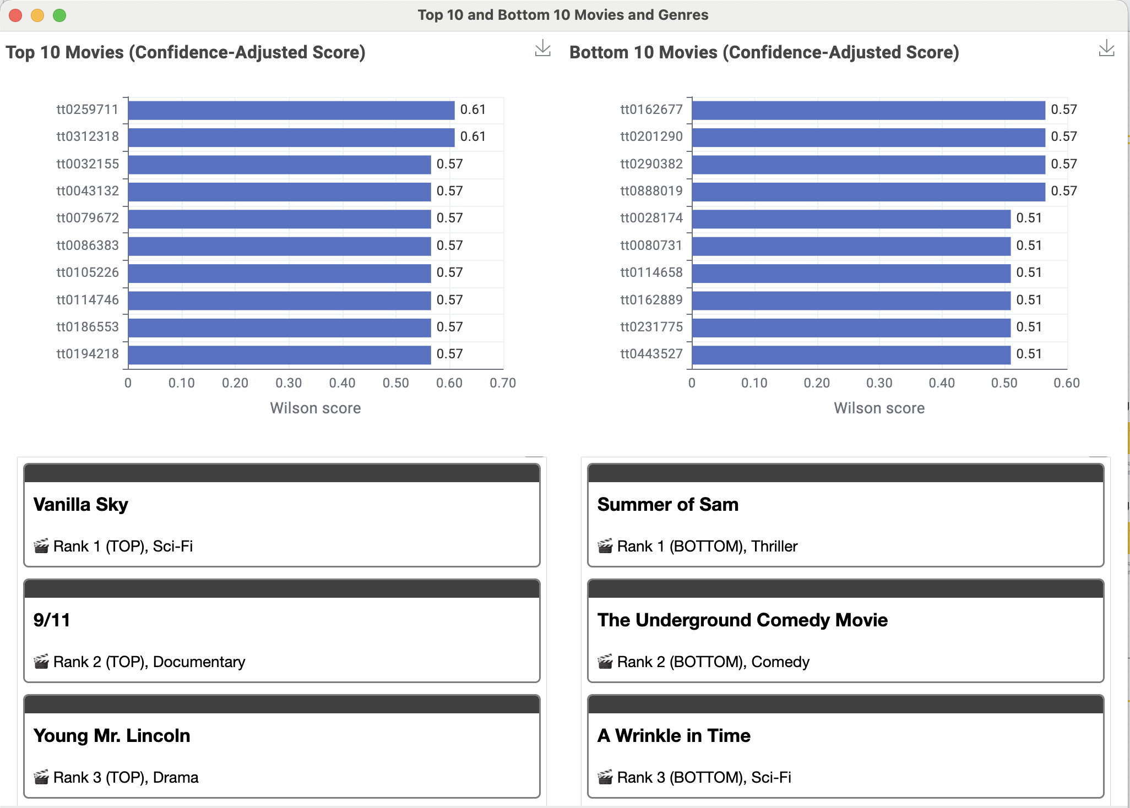
Top 10 and Bottom 10 Movies and Genres
Key Insights
Top movies maintain higher Wilson scores (0.57 – 0.61)
Wilson score adjusts for rating confidence, ranking movies more reliably
Top 10 movies span multiple genres, showing broad positive reception
Bottom 10 movies concentrate in Comedy and Horror genres
Drama dominates the top group with four strong titles
Horror appears four times in the bottom group

Slide 9
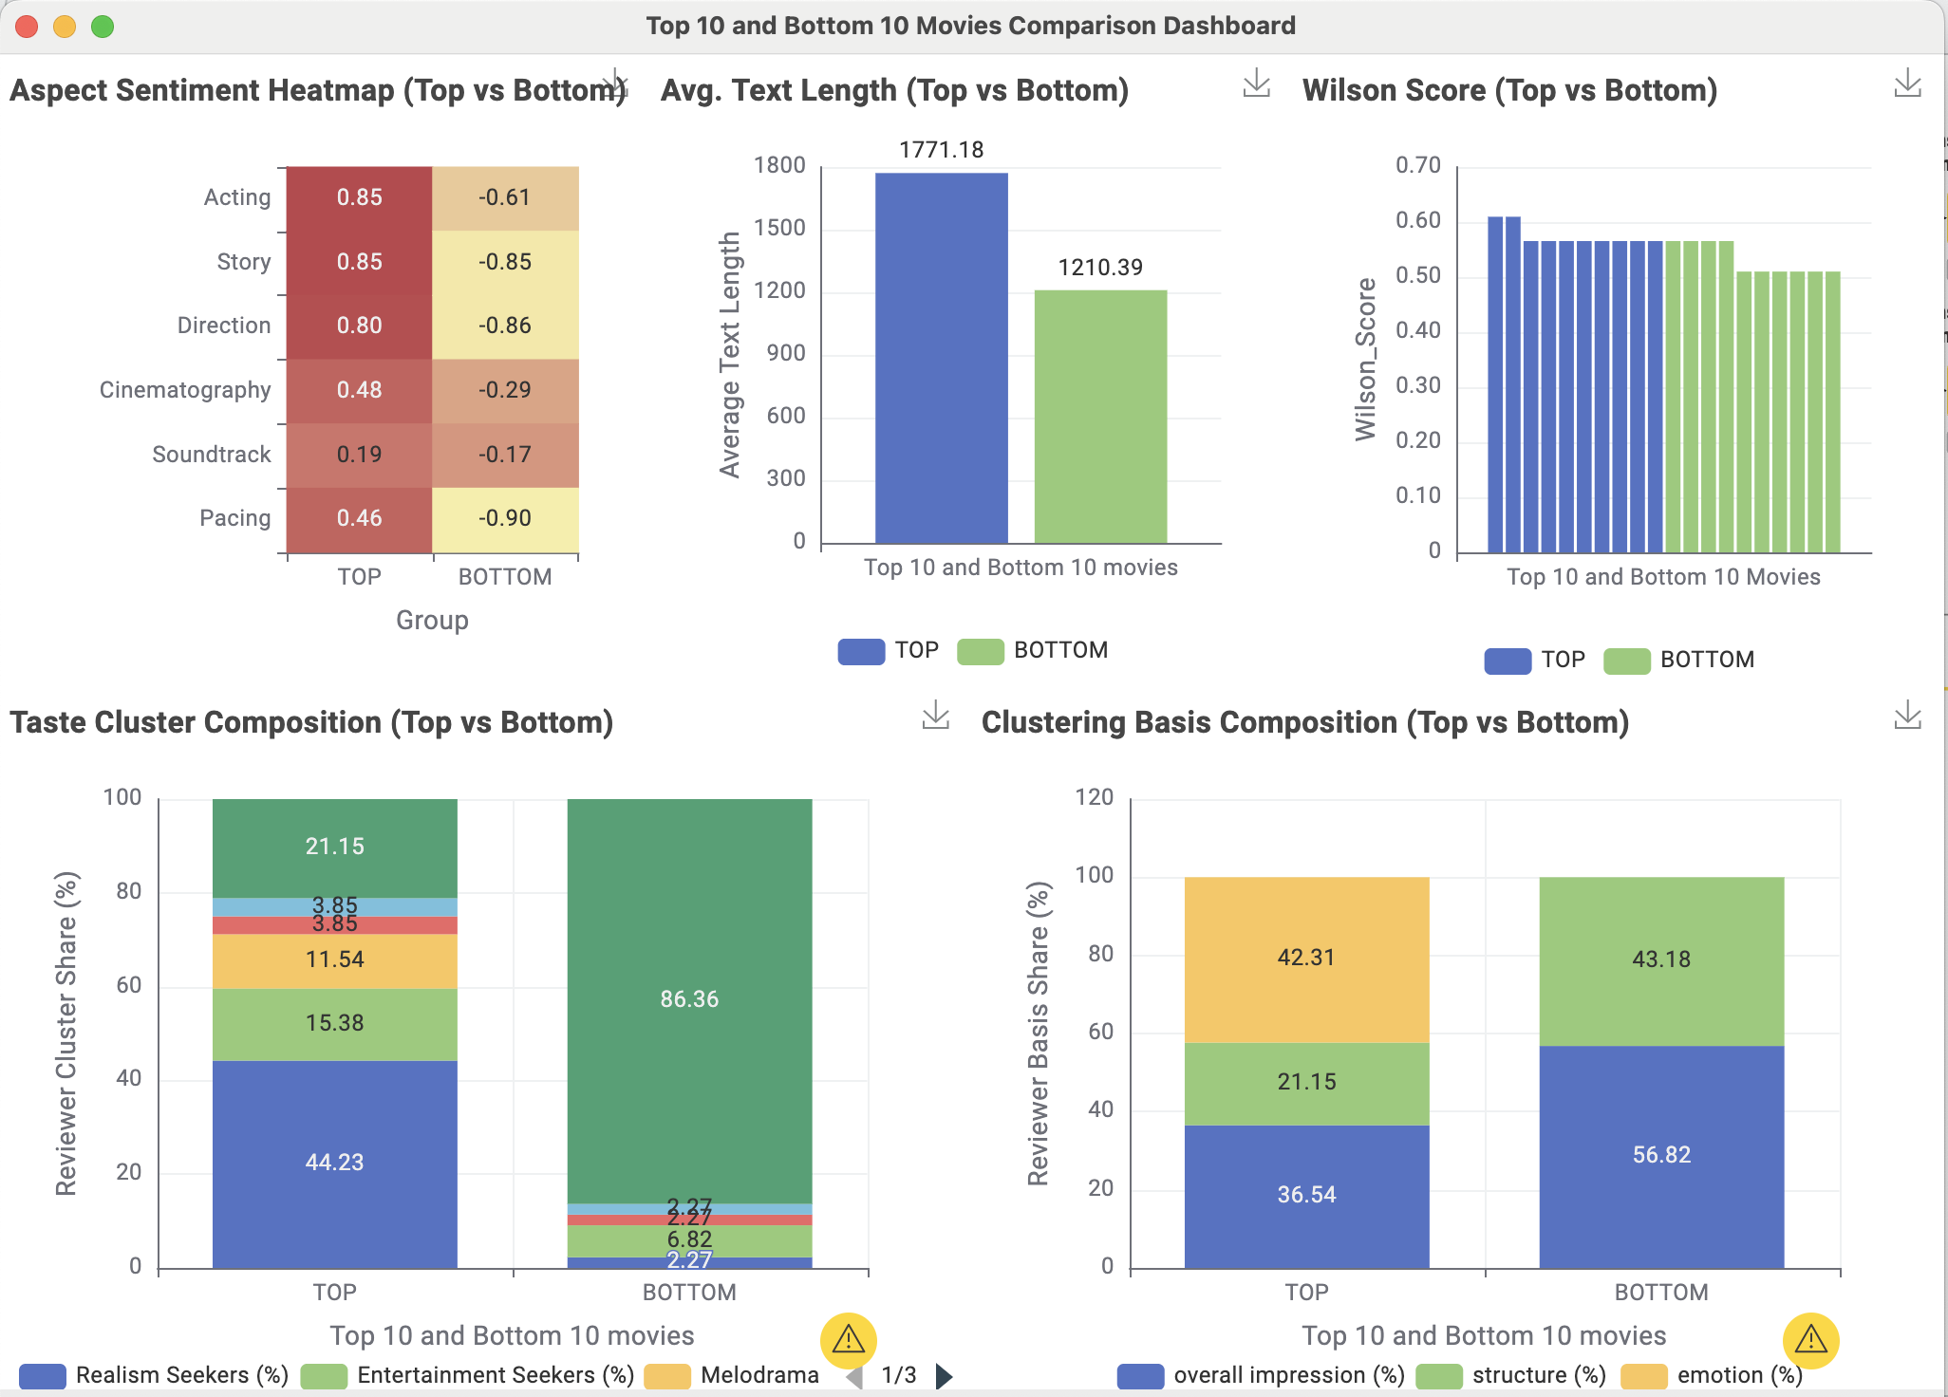
What Distinguishes Top vs Bottom Movies?
Key Insights
Top movies score higher across every aspect sentiment - Acting, Story, Direction all strongly positive
Bottom movies show negative sentiment across all aspects - Pacing, Story, Direction esp. low
Top movies receive longer, more detailed reviews (~1771 vs ~1210 words)
Bottom movies attract far more Plot Critics (86% vs 21%)
Top movies attract more diverse reviewer segments
Top movies show 42% emotion; bottom movies show virtually 0%

Slide 10
Key Takeaways & Insights
Sentiment Understanding
GenAI revealed deeper tone, nuance, and emotional patterns across reviews.
Aspect Advantage
Reviewer Behavior
1
GenAI enabled aspect-level sentiment (Acting, Story, Direction, Cinematography, Soundtrack, Pacing), impossible with ML.
2
Top movies attracted diverse, emotionally engaged reviewers; bottom movies attracted more Plot Critics.
Taste Segmentation
GenAI clusters produced clear reviewer personas; ML clusters were uneven.
Genre Patterns
Text Depth
3
4
Movie-Level Signals
Top movies showed stronger Acting/Story sentiment; bottom movies weaker overall.
Top movies spanned many genres; bottom movies centered on Comedy and Horror.
Top movies received longer, richer reviews; bottom movies shorter and surface-level.

Slide 11
Thank You!

Slide 12
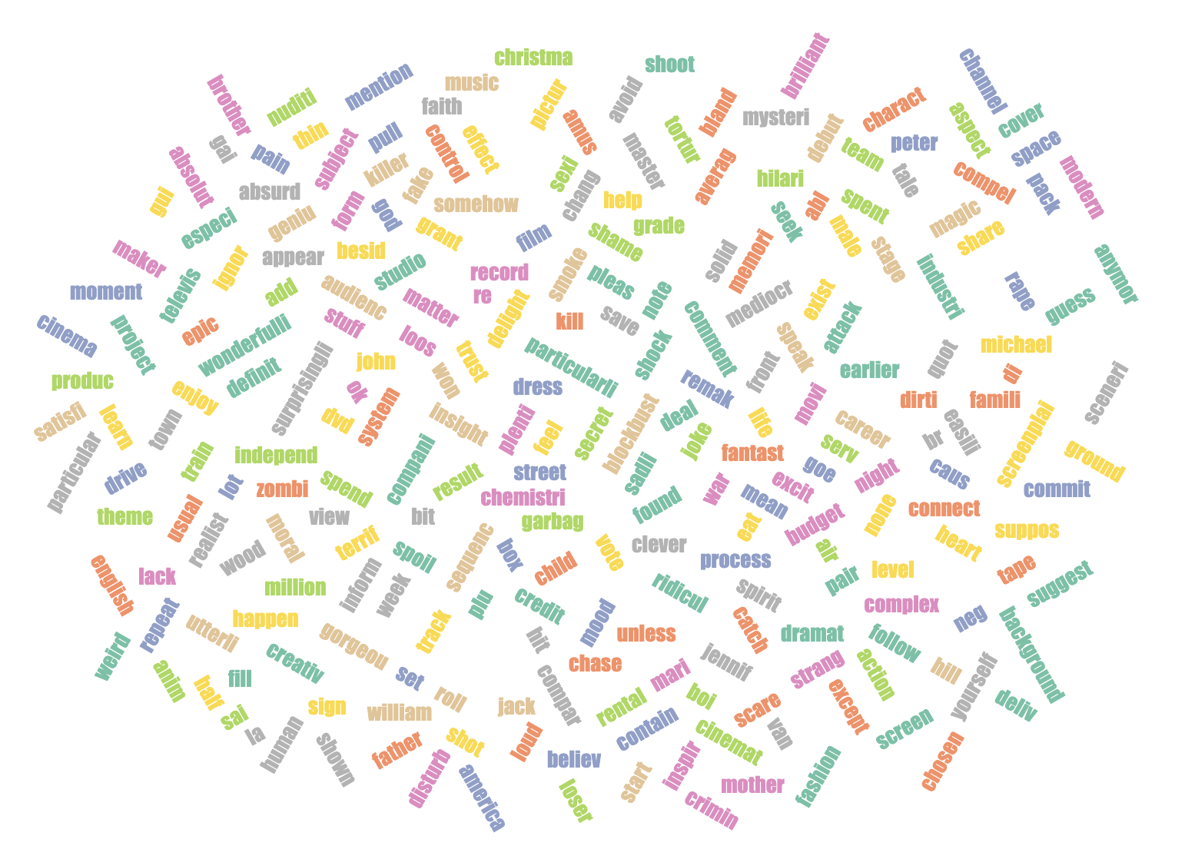
Traditional ML Based Clustering
Cluster | Label | High-Weight Words | Interpretation
Cluster 0 | Mainstream Enthusiasts | film, watch, time, love, act | Seek balanced enjoyment – acting + story + pace. Represent general audience taste.
Cluster 1 | Realism Seekers | real, life, people, character, story | Prefer believable, human stories and emotional authenticity.
Cluster 2 | Plot Critics | plot, scene, story, bad, waste | Judge movies on narrative logic & writing quality.
Cluster 3 | Melodrama Buffs | recommend, music, perfect, real, laugh | React to emotional and musical resonance; value warmth and connection.
Cluster 4 | Entertainment Seekers | fun, laugh, action, recommend, enjoy, watch | Care most about humor, pace, and excitement – the “fun factor.”

Slide 13
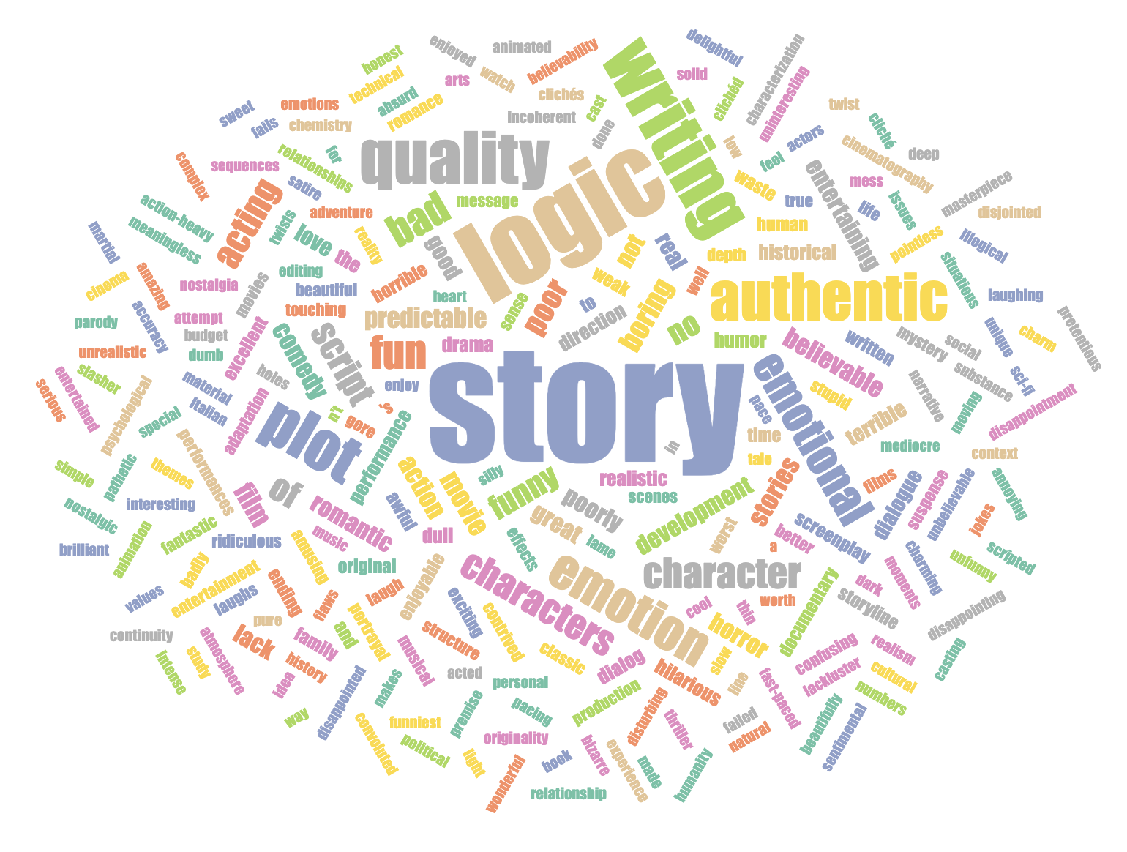
GenAI Based Clustering
Cluster | Label | Top Key Words | Interpretation
1 | Entertainment Seekers | fun, entertaining, comedy, hilarious, action, laugh, enjoyable, exciting, humor | Care most about humor, pace, and excitement – the “fun factor.”
2 | Genre Loyalists | horror, sci-fi, Star Trek, animation, fantasy, anime, classic, comedy, low budget, martial arts | Consistently praise or criticize specific genres (e.g., horror, comedy, sci-fi, romance).
3 | Melodrama Buffs | emotional, romantic, love, emotional stories, romance, love story, touching, beautiful, emotion, heartwarming | Drawn to emotional, romantic, or inspirational films with strong feelings or music.
4 | Plot Critics | story logic, writing quality, boring, story, character development, predictable, script, plot, bad acting, characters | Focus on story logic, writing quality, and script coherence.
5 | Realism Seekers | authentic emotion, authentic, believable stories, documentary, realistic, believable, realism, true story, emotional, real | Value believable stories, authentic emotion, and human characters.
6 | Others | bizarre, disturbing, nostalgia, historical context, interpretation, low budget, psychology, spoof, weird

